Slide 1
Weather Disaster and Early warning application
Faizan Sharif FA21-BSE-007
Salman Sharif FA21-BSE-056
Supervised By: Kalim Sattar

Slide 2
Introduction:
🌪️ Weather-Related Disasters Are Increasing: Natural disasters like cyclones, floods, tornadoes, and heavy rainfall are becoming more frequent and intense due to climate change.
High-Risk Communities Are Vulnerable: Millions of people living in disaster-prone areas lack access to real-time warnings, putting lives and property at risk.
Technology Is Underutilized in Disaster Response: Despite the availability of smartphones and internet access,most alert systems fail to provide timely and targeted disaster notifications.
Why This Topic Matters: Effective early warning systems can drastically reduce casualties, enhance preparedness, and support emergency responders during critical events.

Slide 3
Problem Statement
Lack of Timely Alerts: Many weather applications fail to provide real-time, location-specific alerts for disasters like
cyclones, floods, and tornadoes.
Insufficient Specificity: Existing systems often give general forecasts, missing the critical details required for early
response in high-risk zones.
Limited Public Awareness & Preparedness: Without accurate and early warnings, people are unprepared to take life-saving actions during
extreme weather conditions.
No Personalization: Alerts are not tailored to individual needs or geographic locations, reducing their effectiveness.

Slide 4
Objective:
Deliver Real-Time Alerts: Notify users immediately of severe weather events like cyclones, floods, tornadoes, and heavy rain.
Enable Location-Based Warnings: Provide personalized alerts based on users’ GPS or selected locations.
Enhance Disaster Preparedness: Help individuals and authorities take timely actions to minimize damage and save lives.
Integrate Trusted Data Sources: Utilize reliable datasets from CMA and OpenWeatherMap for accurate forecasting.
Offer a User-Friendly Mobile App: Design an intuitive interface for Android using Flutter, ensuring accessibility for all users.
Support Public Safety Initiatives: Strengthen community response and planning through effective early warning mechanisms

Slide 5
Scope of the project:
Real-Time Disaster Alerts For cyclones, tornadoes, floods, and heavy rainfall based on Historical weather data.
Location-Based Notifications Customized alerts for user-selected or GPS-detected locations.
Mobile Application (Android) Built with Flutter for a responsive, cross-platform experience.
Customizable Alert Preferences Users can choose which types of alerts they want to receive and their severity level.
🗺️ Interactive Weather Maps Visual representation of affected areas and storm paths.

Slide 6
Literature Review / Related Work
Personalized, Real-Time Alerts: Immediate push notifications based on user preferences and live data.
Location-Aware Notifications: Uses GPS or manual location input for targeted warnings.
Focused on Life-Threatening Weather Events: Specialized for cyclones, floods, tornadoes, and heavy rainfall.
User-Friendly Mobile App (Flutter): Clean interface optimized for Android devices.
Integration of Reliable Data Sources: Combines data from CMA and OpenWeatherMap for high accuracy.

Slide 7
Proposed Solution:
A mobile-based Weather Disaster and Early Warning Application that delivers real-time, location-specific alerts for extreme weather conditions such as cyclones, floods and heavy rainfall.
Built using Flutter (frontend) and Python (backend), the app integrates reliable weather data sources like CMA and OpenWeatherMap.

Slide 8
Technologies Used
Flutter: Cross-platform mobile app development (UI for Android)
Python (Flask): Backend logic, data ingestion, and alert processing
Firebase:
Firestore for database
Firebase Auth for login/signup
Firebase Cloud Messaging (FCM) for real-time push alerts
CMA & OpenWeatherMap APIs: Trusted sources for live weather data
Google Maps API: For location tracking and interactive weather maps

Slide 9
Feature Implementation:
Real-Time Alerts: Fetched via Python backend from CMA & OpenWeatherMap
User Authentication: Handled using Firebase Auth (Email/Password login via Flutter).
Push Notifications: Delivered using Firebase Cloud Messaging based on user location & preferences.
Location Services: Integrated via Google Maps API & GPS for accurate, location-based alerts.
Custom Alert Preferences: Stored in Fire store; users choose alert types and severity levels.
🗺️ Interactive Weather Maps: Google Maps embedded in Flutter to show storms and red zones visually.

Slide 10
Challenges:
API Limitations: Some free weather APIs had request limits and data latency.
Accurate Location Detection: Ensuring precise GPS tracking and fallback for manual input was complex.
Real-Time Notification Sync: Timing push alerts reliably across devices required careful testing.
Testing Real Disasters: Simulating real-world disaster conditions without live events was difficult.
Connectivity Dependence: Internet access is essential for real-time data, limiting offline functionality.
UI Responsiveness: Ensuring smooth performance across various Android devices.

Slide 11
Project Properties
User can Sign up / Login
Get the real time weather and Notifications
Detection of the cyclones on the based of historical data.
Notifications on the based of the Rains and floods
Give feedback about the project

Slide 12
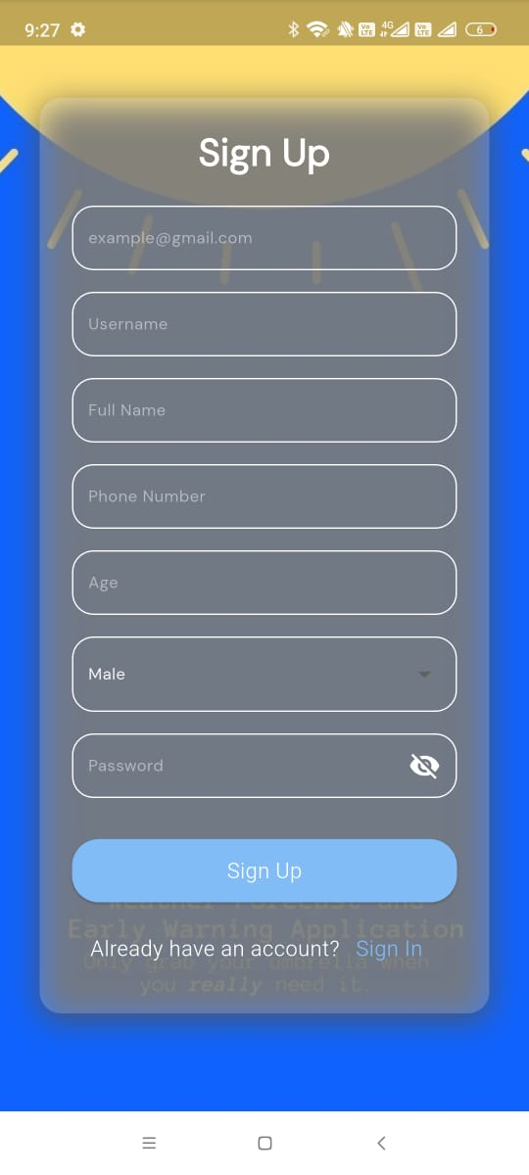
Login Screen

Slide 13
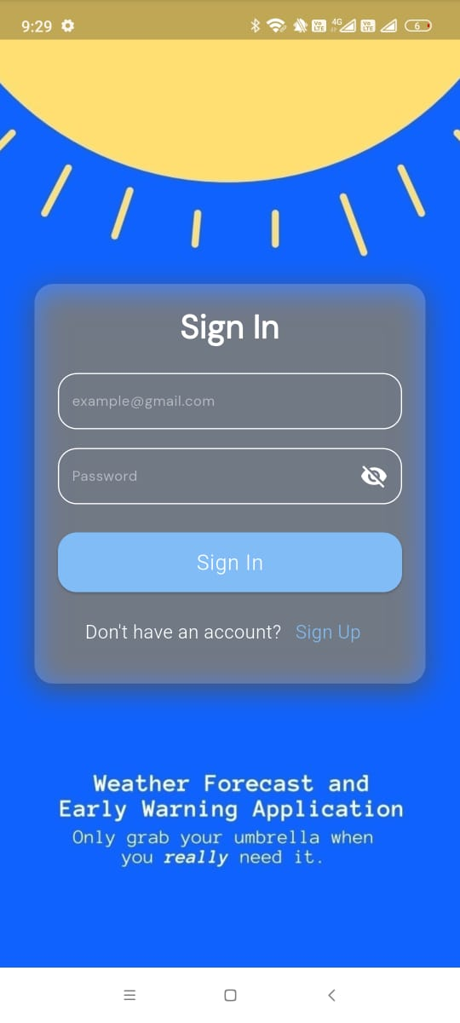
Signup Screen:

Slide 14
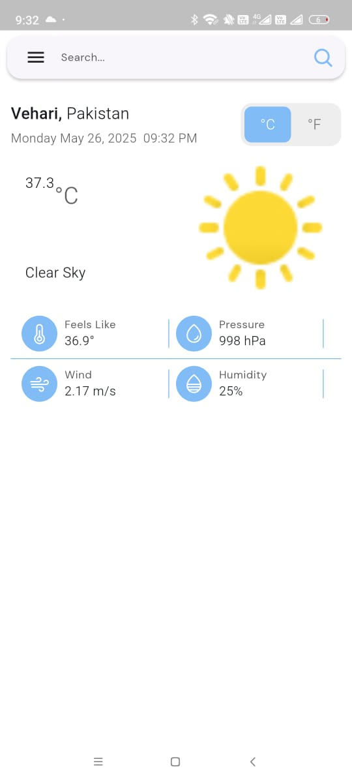
Main Screen:

Slide 15
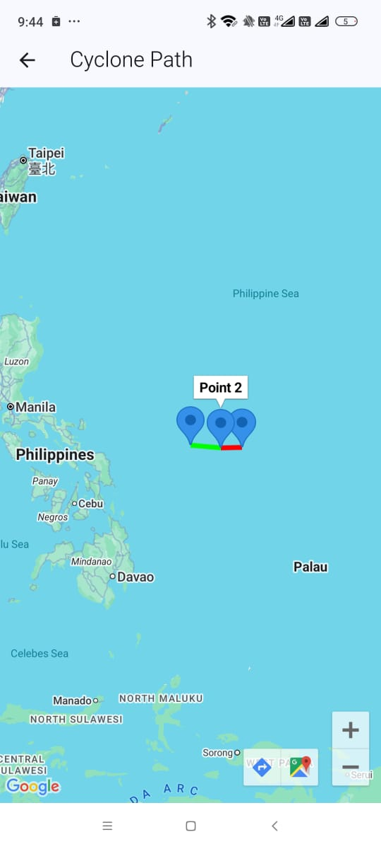
Cyclones Path

Slide 16
Testing Methods:
Manual Testing:
Tested core features on Android devices
Verified login, alerts, map display, and preferences
Functional Testing:
Simulated weather events to trigger real-time alerts
Checked GPS-based notification accuracy
Unit Testing:
Backend alert logic and data fetching tested in Python

Slide 17
Conclusion:
Developed a real-time weather disaster alert app for Android
Integrated CMA & OpenWeatherMap APIs for accurate data
Implemented location-based, customizable alerts using Flutter & Firebase
Designed a user-friendly UI with interactive maps and quick notifications
Here implemented the real time weather detail and notification of weather.
Cyclone detection through the historical data.

Slide 18

Thank You!
Any Question?
Notes:
© Copyright PresentationGO.com – Free Templates & Infographics for PowerPoint and Google Slides

